Slide 1
Accessibility in Windows 10 Jeff Petty & Brett Humphrey Windows Accessibility Program Managers

Slide 2
Agenda
How does Microsoft think about accessibility?
Microsoft Culture
Windows Accessibility
Accessibility Demos
Conclusion and Call to Action

Slide 3


Microsoft Mission
Microsoft Mission
Empower every person and every organization on the planet to achieve more

Slide 4

Empowering People
Every person.
Empowered.
In every context.

Slide 5

How we think about Disability
Disability
Disability
=
Personal health condition
Mismatched human interactions

Slide 6

~70% of disabilities…

Slide 7

are invisible.

Slide 8

Over 1 billion people with disabilities.

Slide 9






8 million experience situational exclusion
Permanent
Temporary
Situational

Slide 10
Part 2
How does Windows 10 make it easier to use your device?
Microsoft Culture
Windows Accessibility
Accessibility Demos
Conclusion and Call to Action

Slide 11
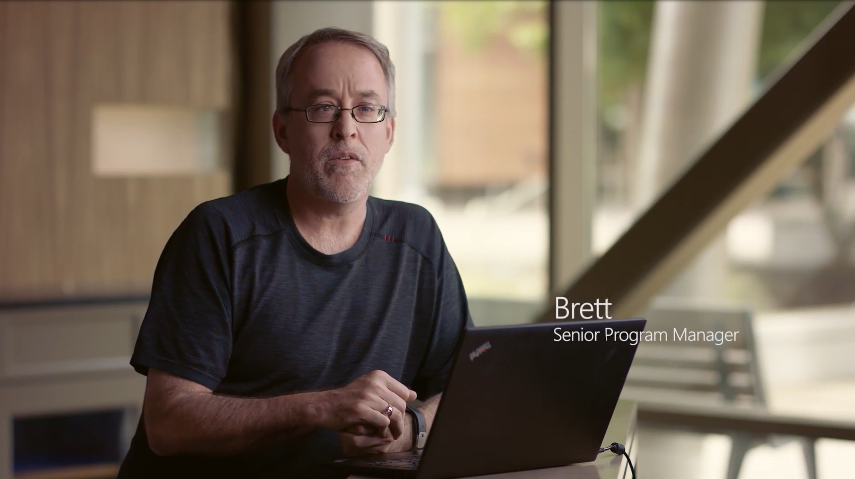

Windows 10 Craftmanship Video

Slide 12


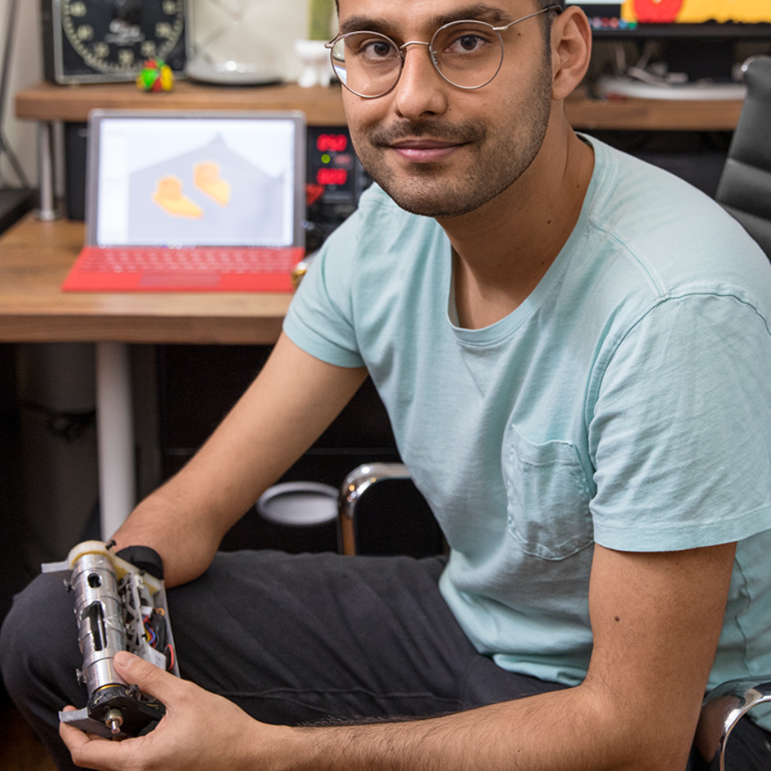
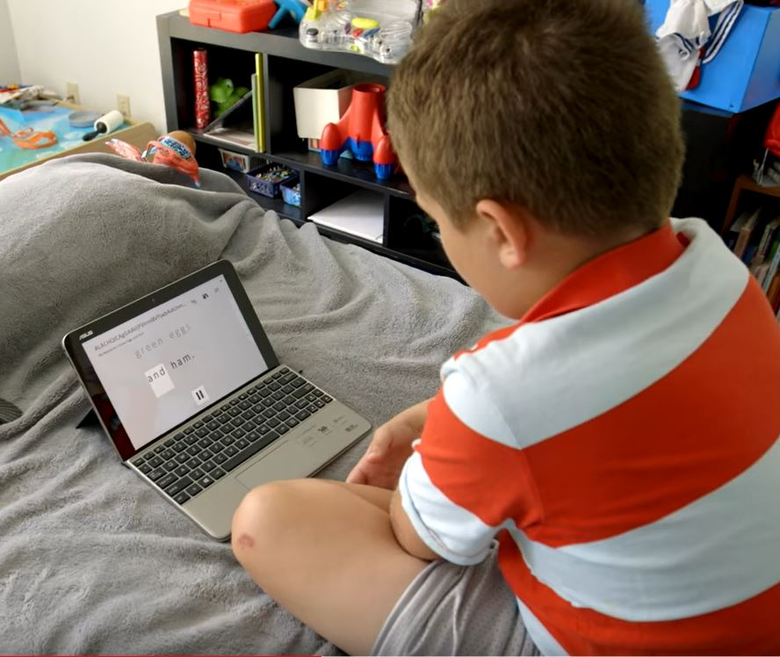
Windows 10 Accessibility
vision
hearing
physical
cognition
Make your device easier to see or use with or without a screen
Make your device easier to hear or use without sound
Make your device easier to use of you have limited reach or strength
Make it easier to focus and get things done with Windows

Slide 13
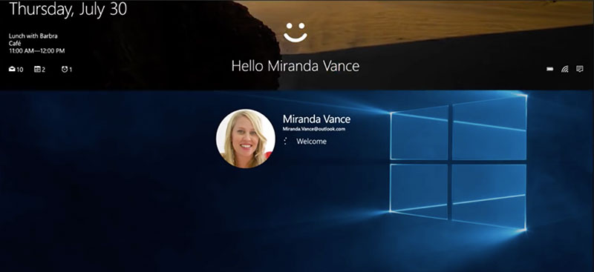
Windows Hello
Have Windows do the work for you

Slide 14
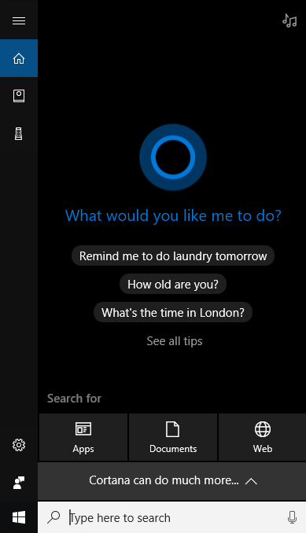
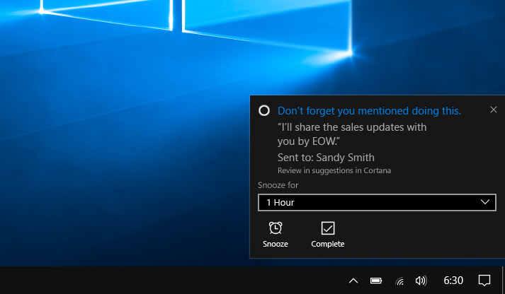
Cortana
Delegate common tasks to, and get help from, to your digital assistant

Slide 15
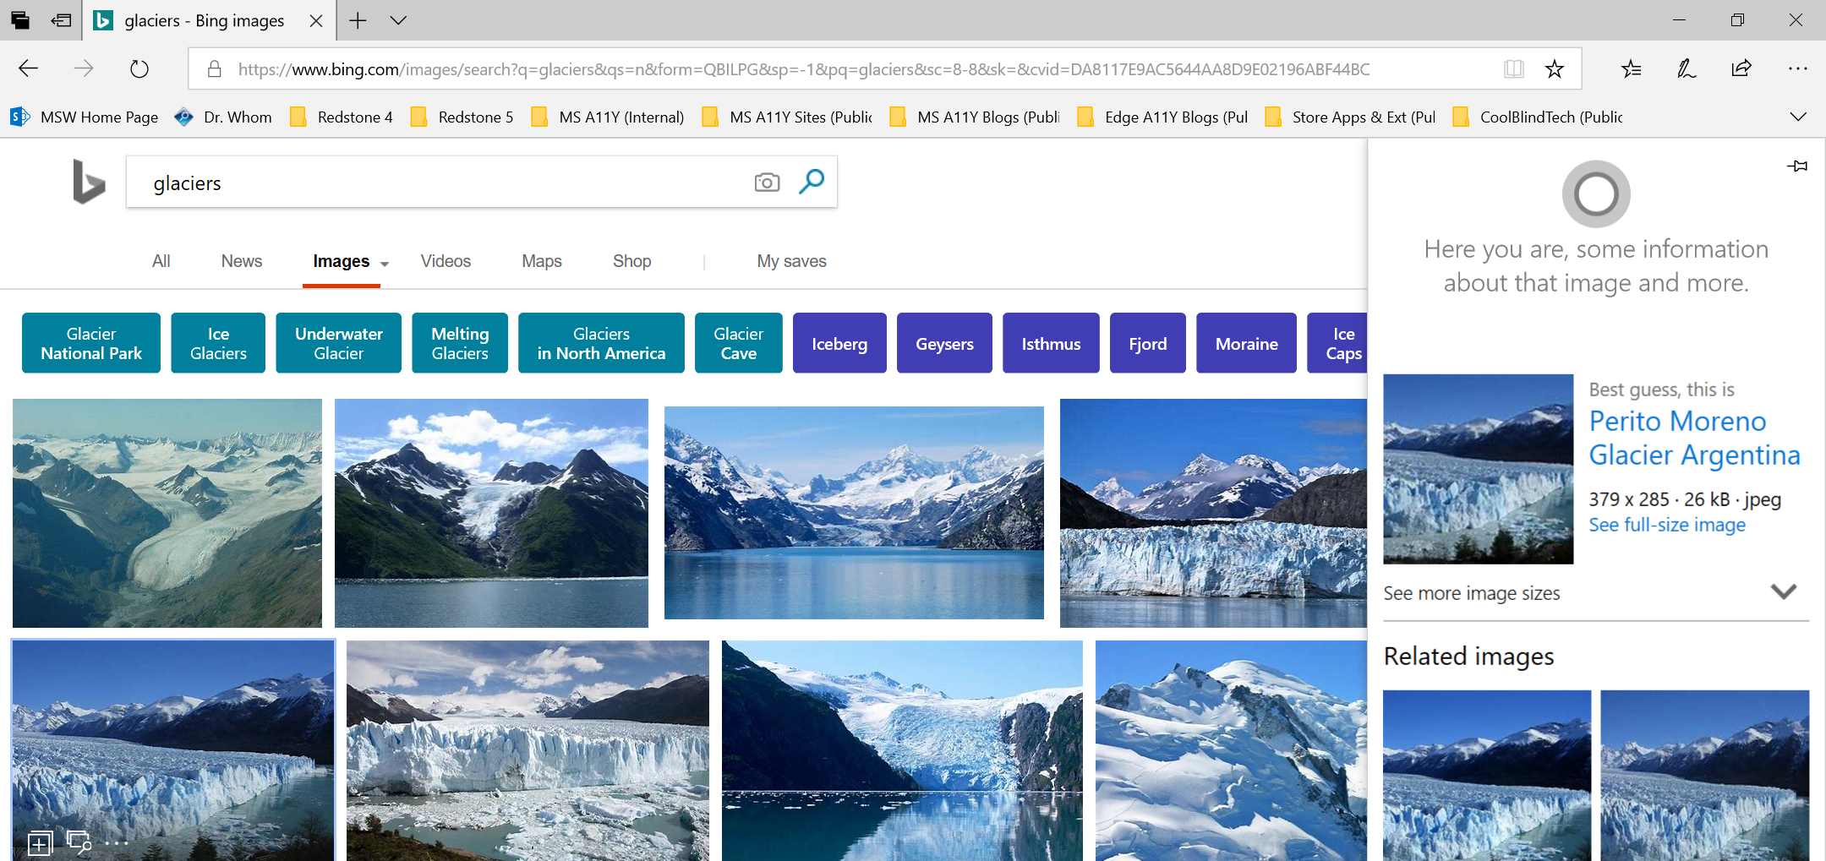
Cortana
Delegate common tasks to, and get help from, to your digital assistant

Slide 16
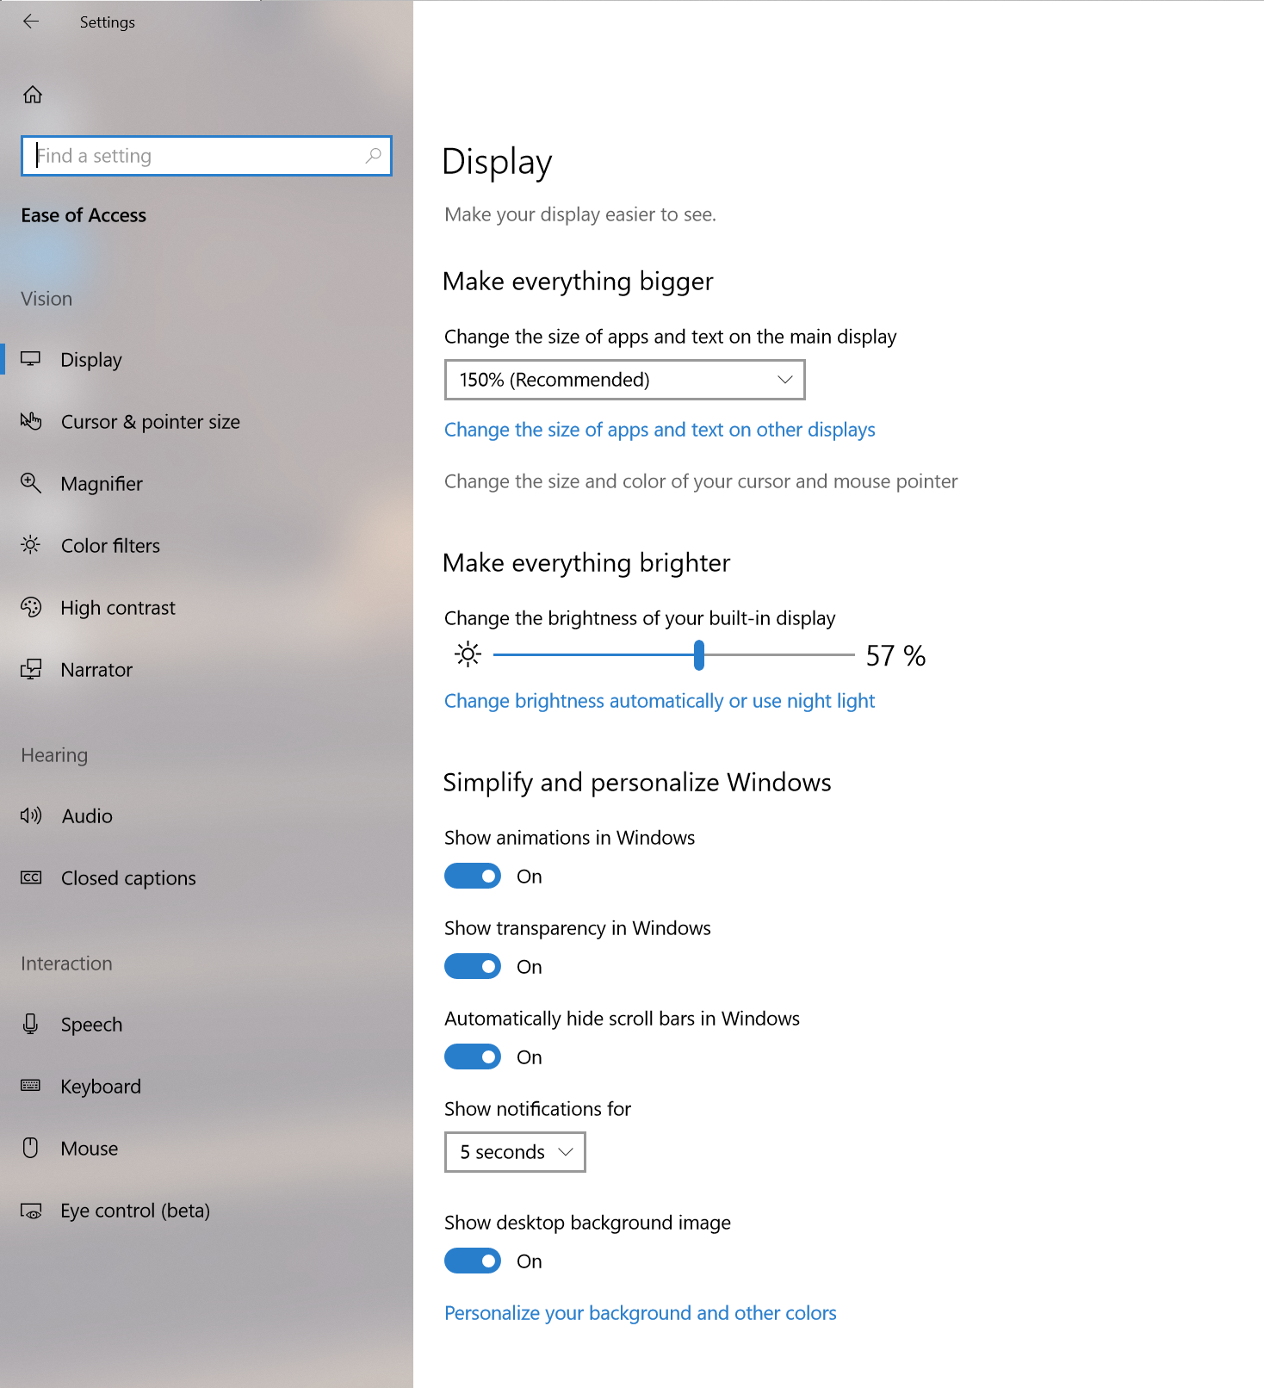
Ease of Access
Make accessibility easier to discover, learn and use
Spotlight: New Ease of Access Settings - Coming Soon!

Slide 17

Vision
Make your device easier to see or use with or without a screen
Spotlight: Narrator Image Descriptions – Recently Added!
“Image of Kanye West with text that reads I’m thankful for myself for being myself”

Slide 18


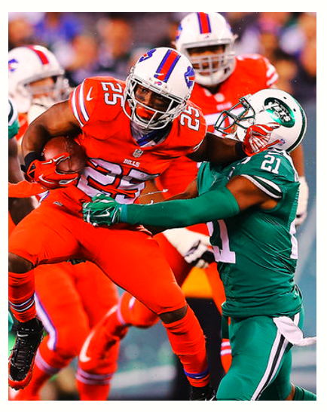
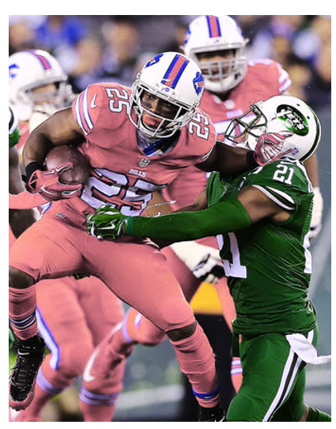

Vision
Make your device easier to see or use with or without a screen
Spotlight: Color Filters – Recently Added!
Greyscale
Deuteranopia
Protanopia
Tritanopia

Slide 19
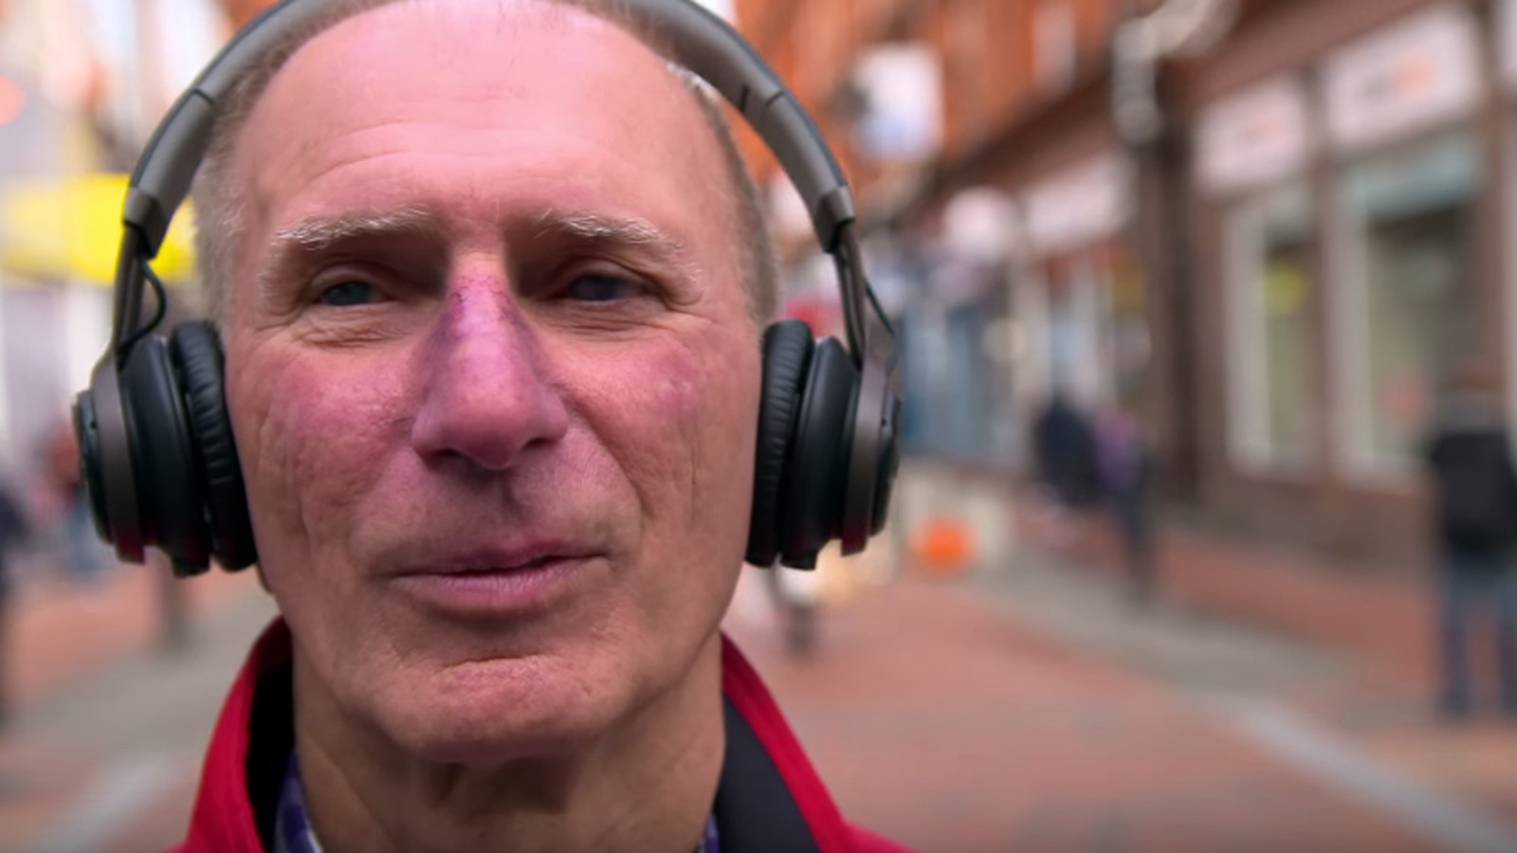
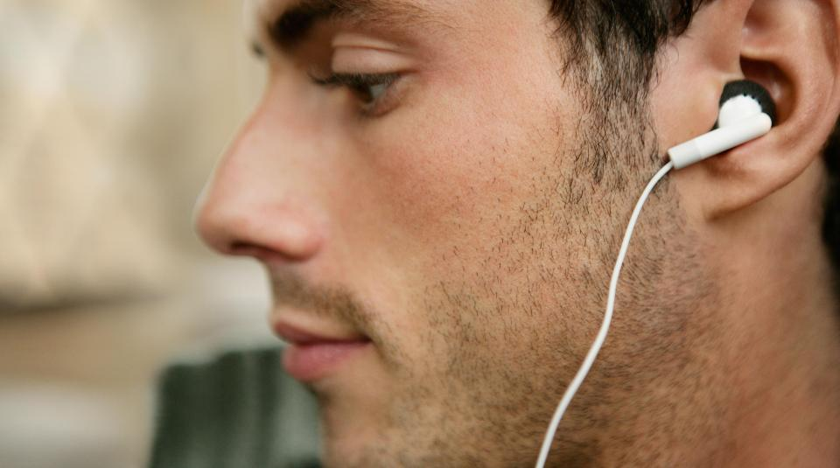
Hearing
Make your device easier to hear or use without sound
Spotlight: Mono Audio – Recently Added!

Slide 20
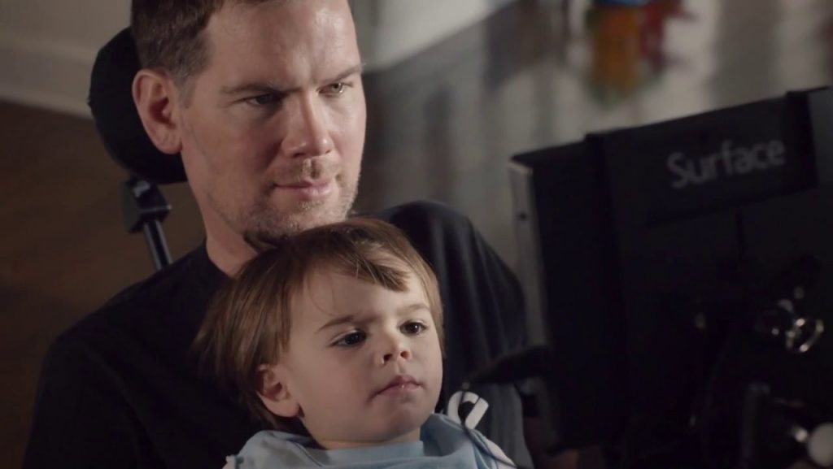
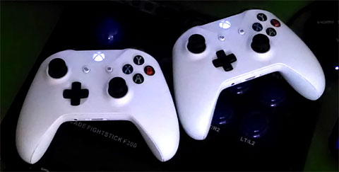
Physical
Make your device easier to use if you have limited reach or strength
Spotlight: Windows Eye Control & Xbox Co-Pilot – Recently Added!

Slide 21
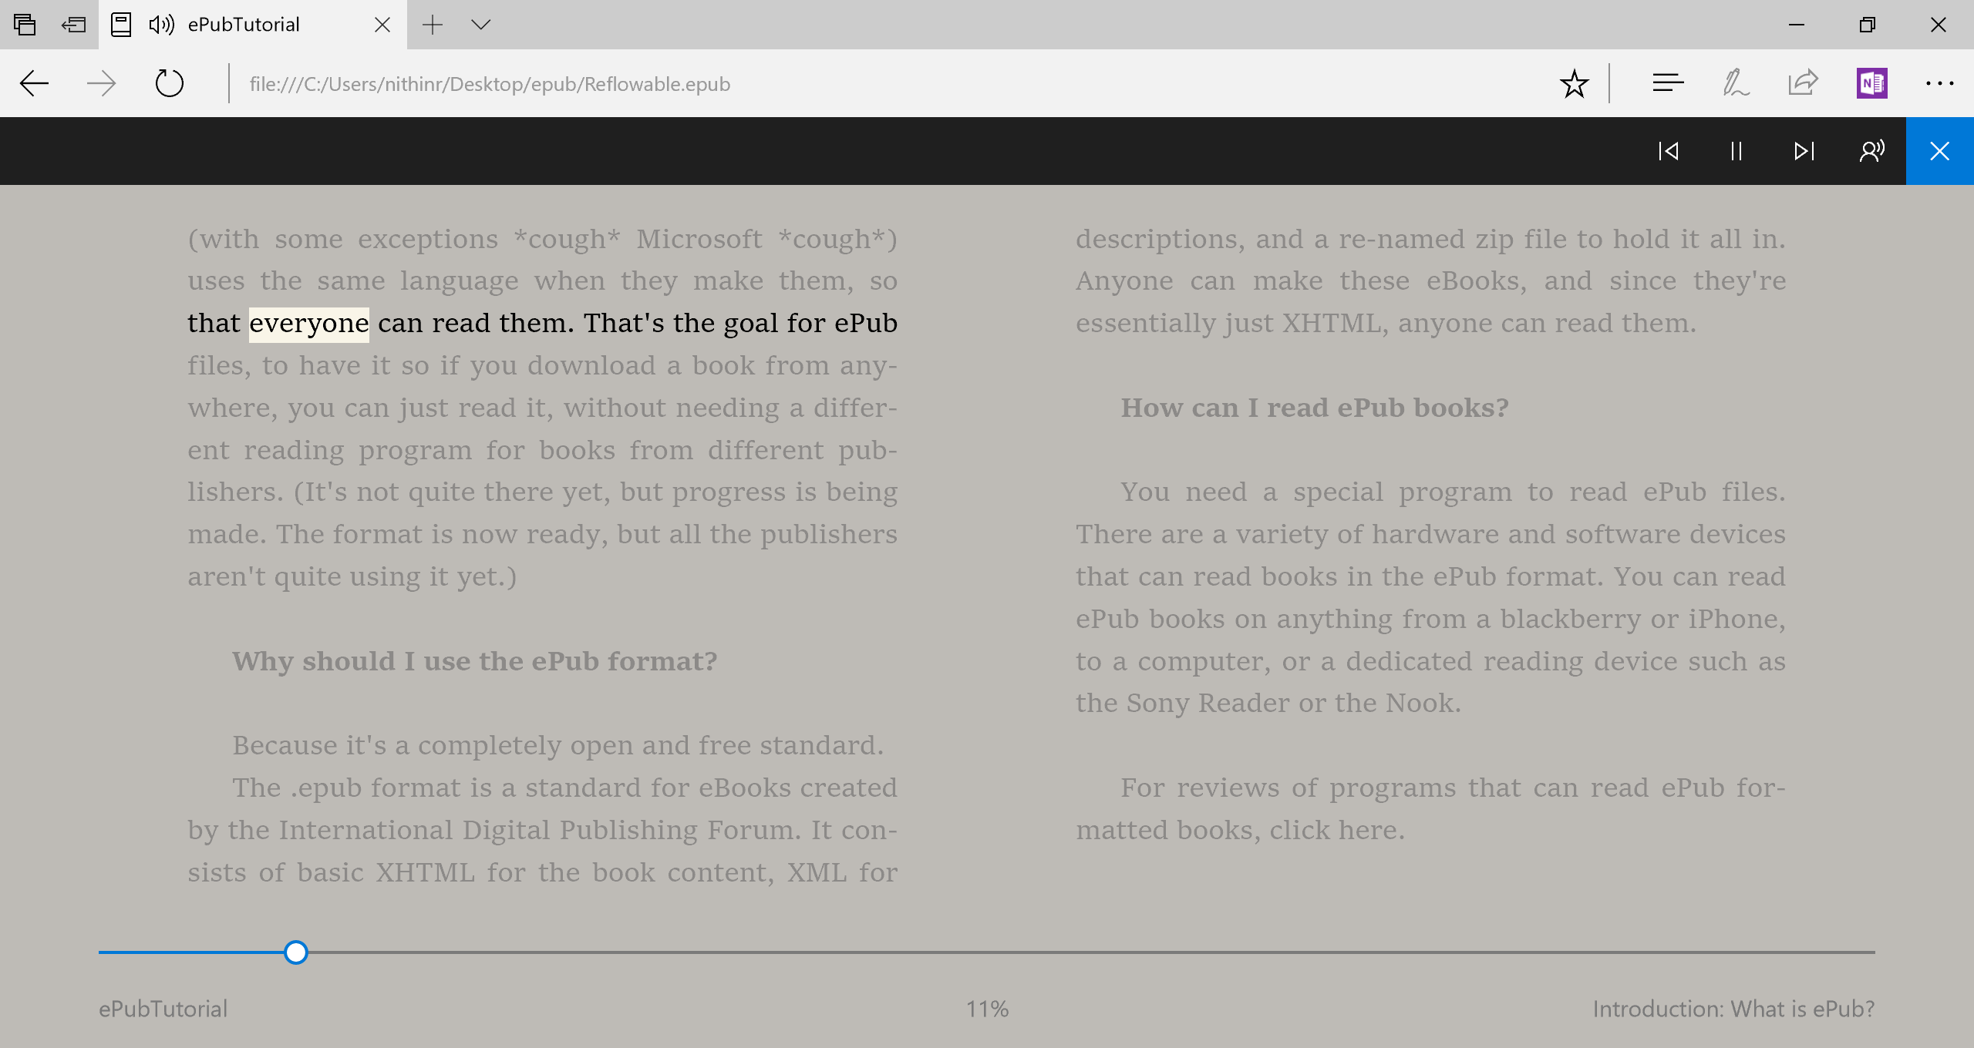
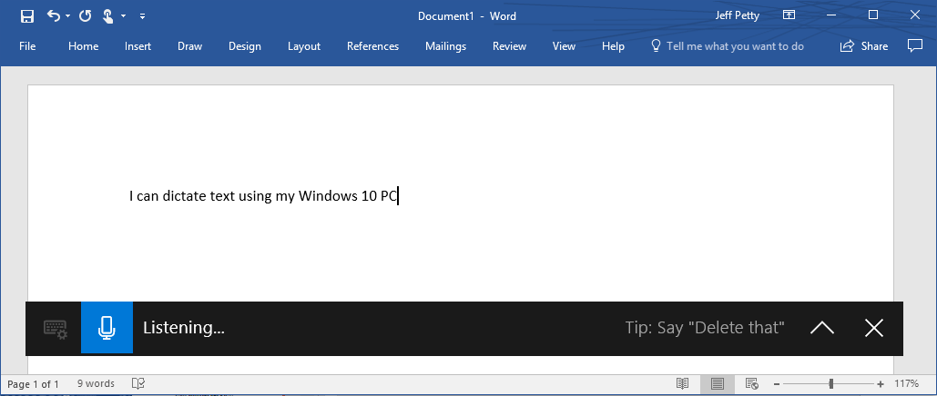
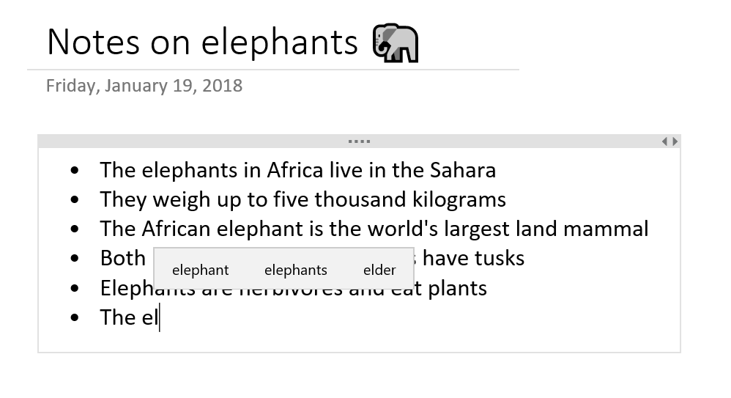
Cognition
Make it easier to focus and get things done with Windows
Learning Tools in Edge Browsing, PDF and ePub – Recently Added!
Windows Dictation – Recently Added!
Text suggestions – Coming Soon!

Slide 22
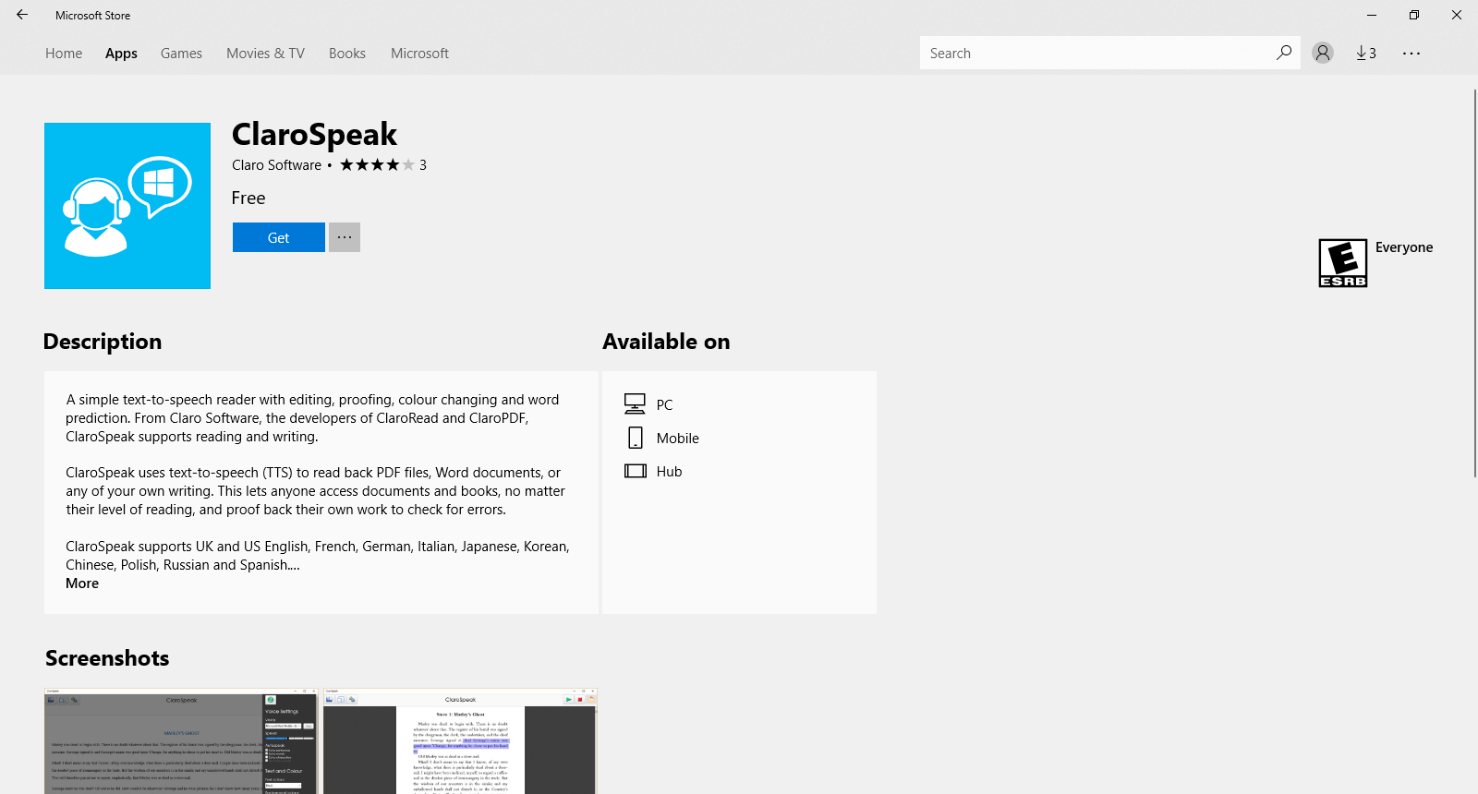
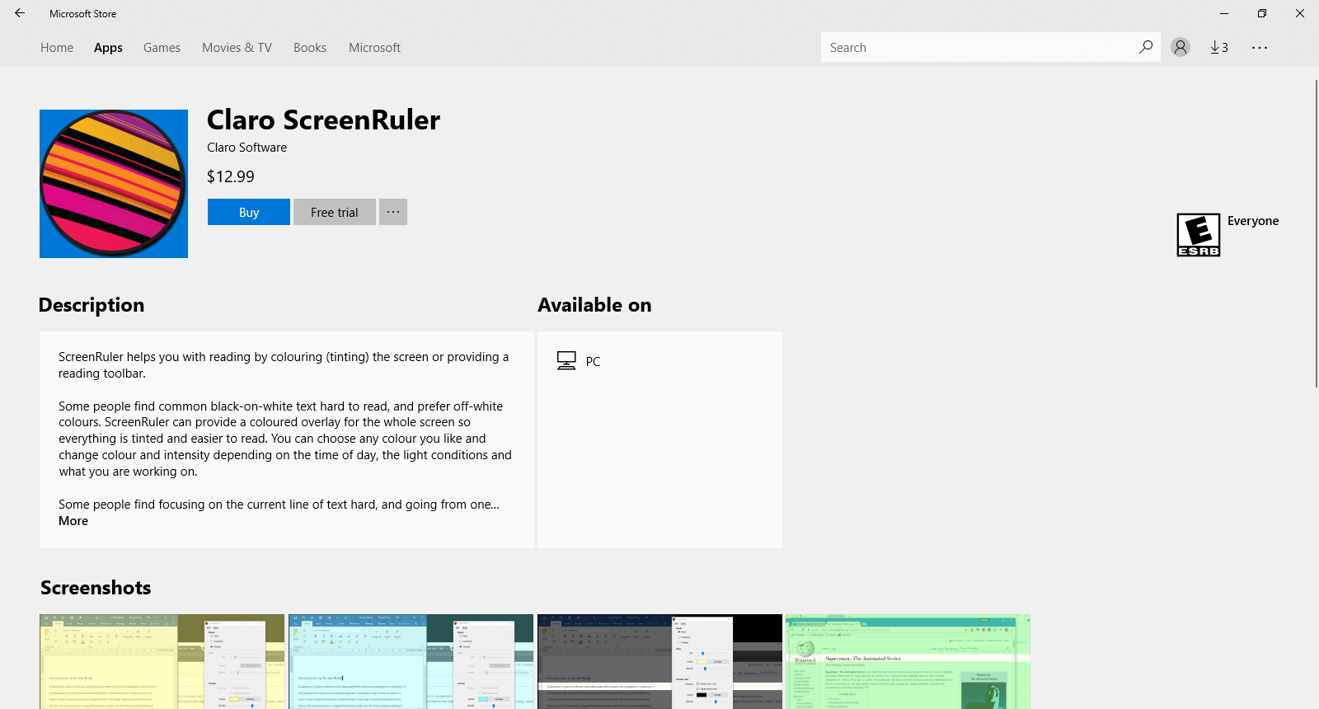
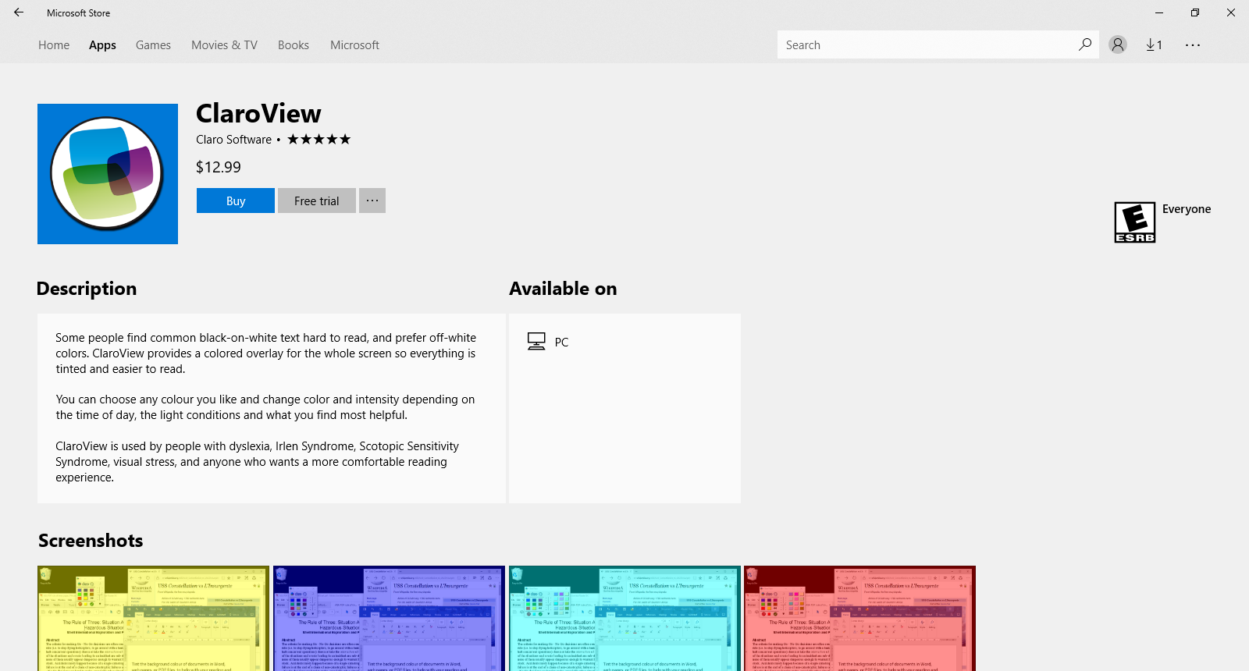
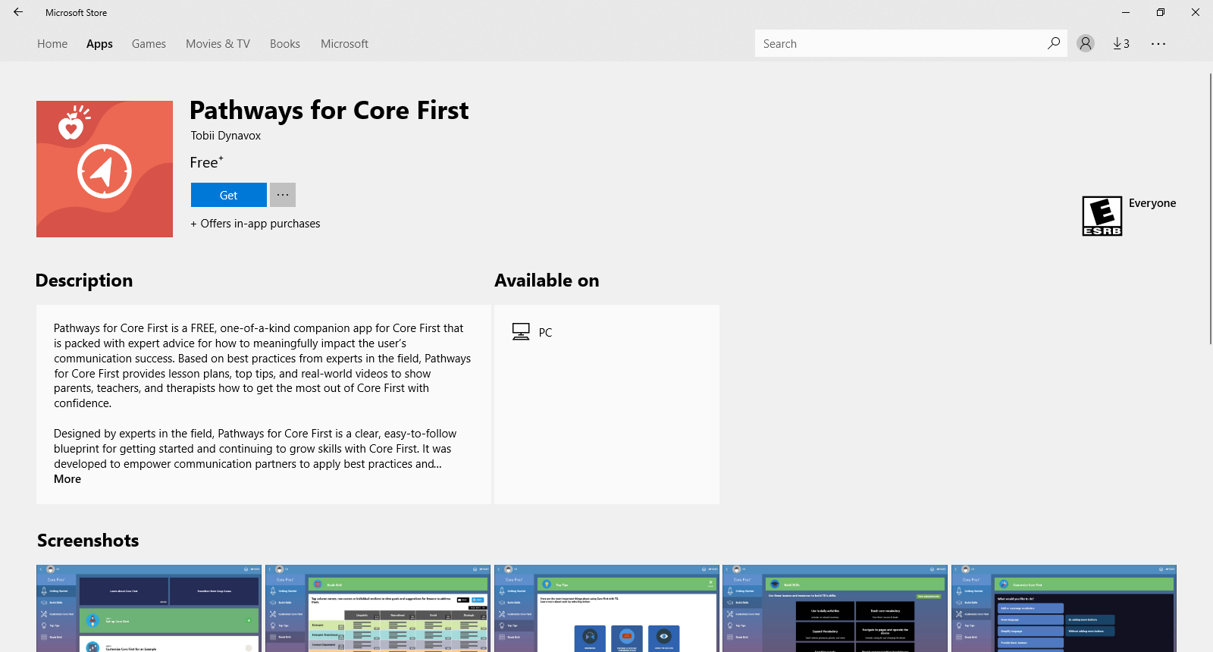
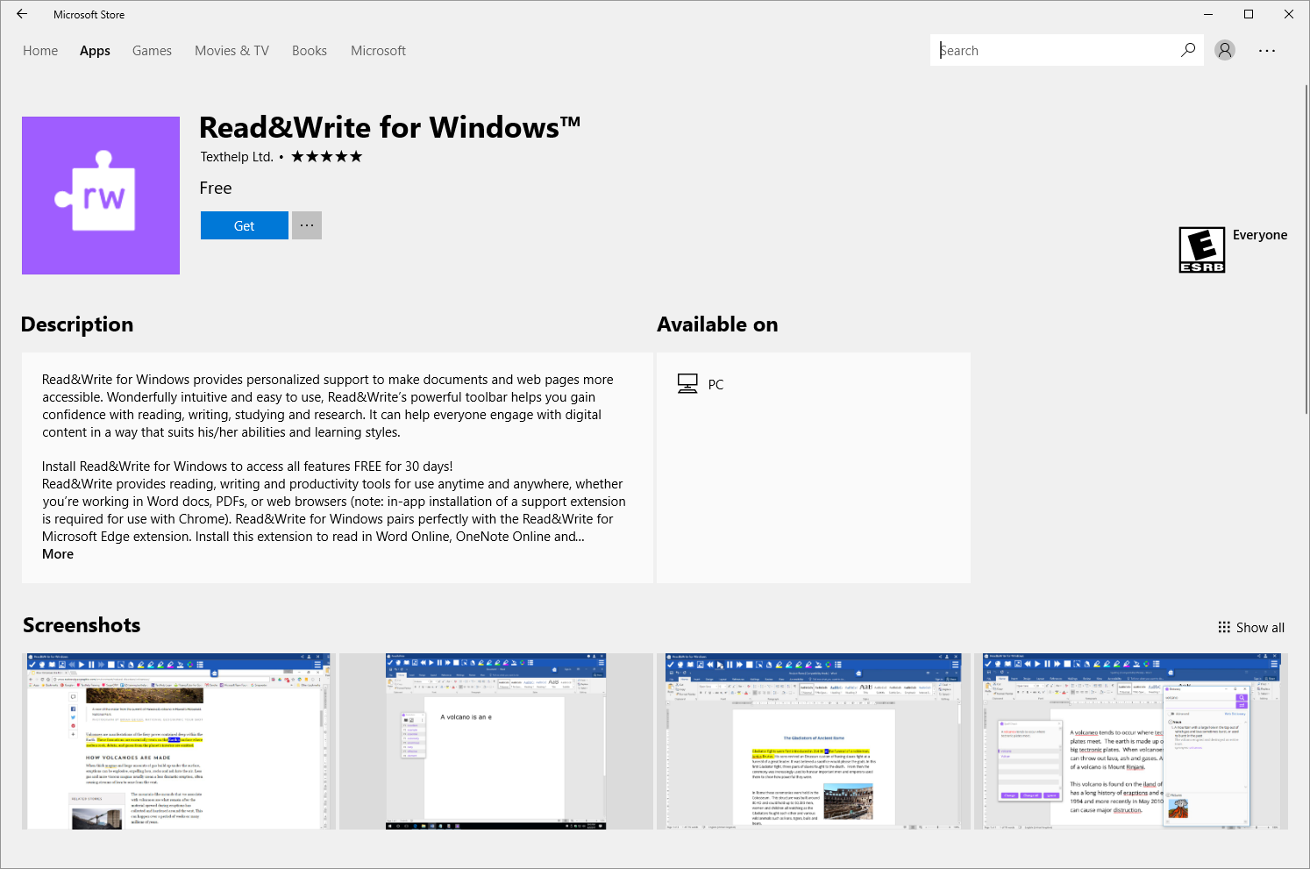
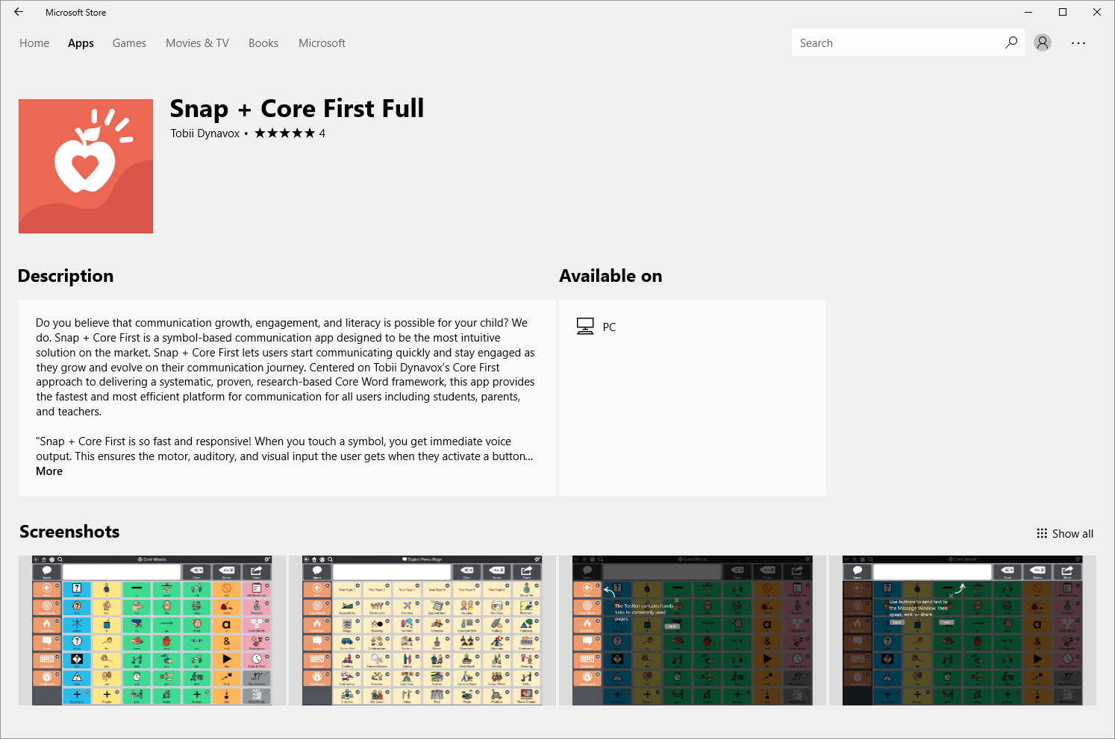
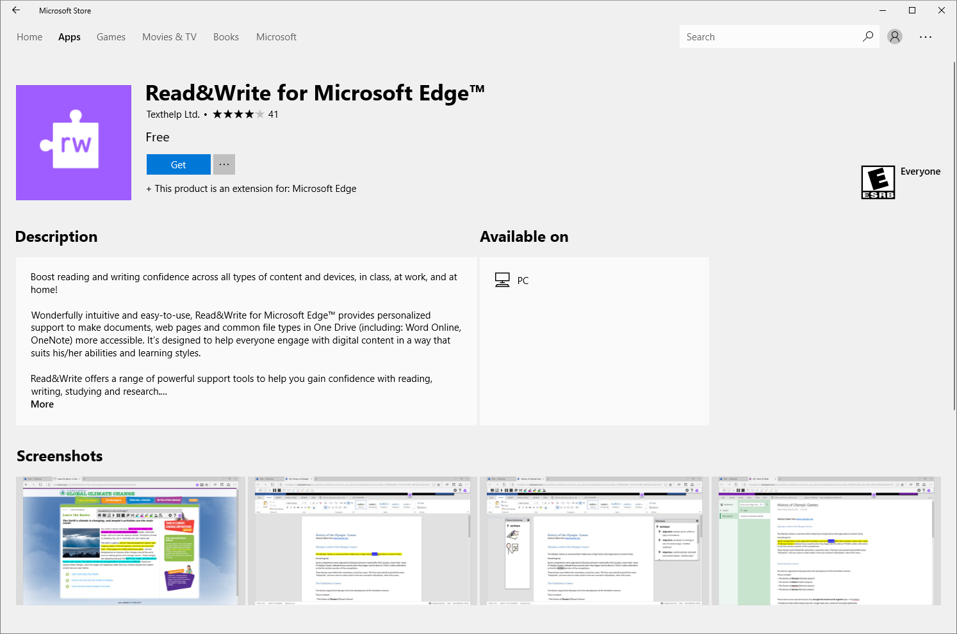
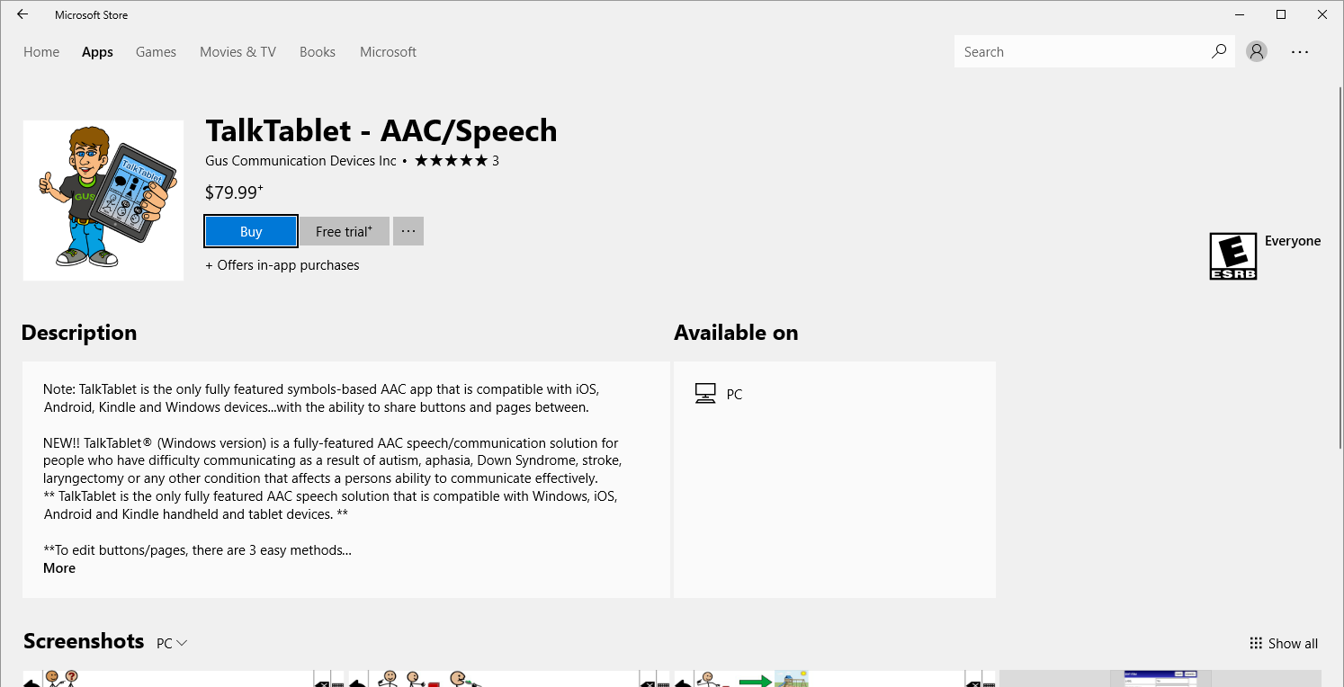
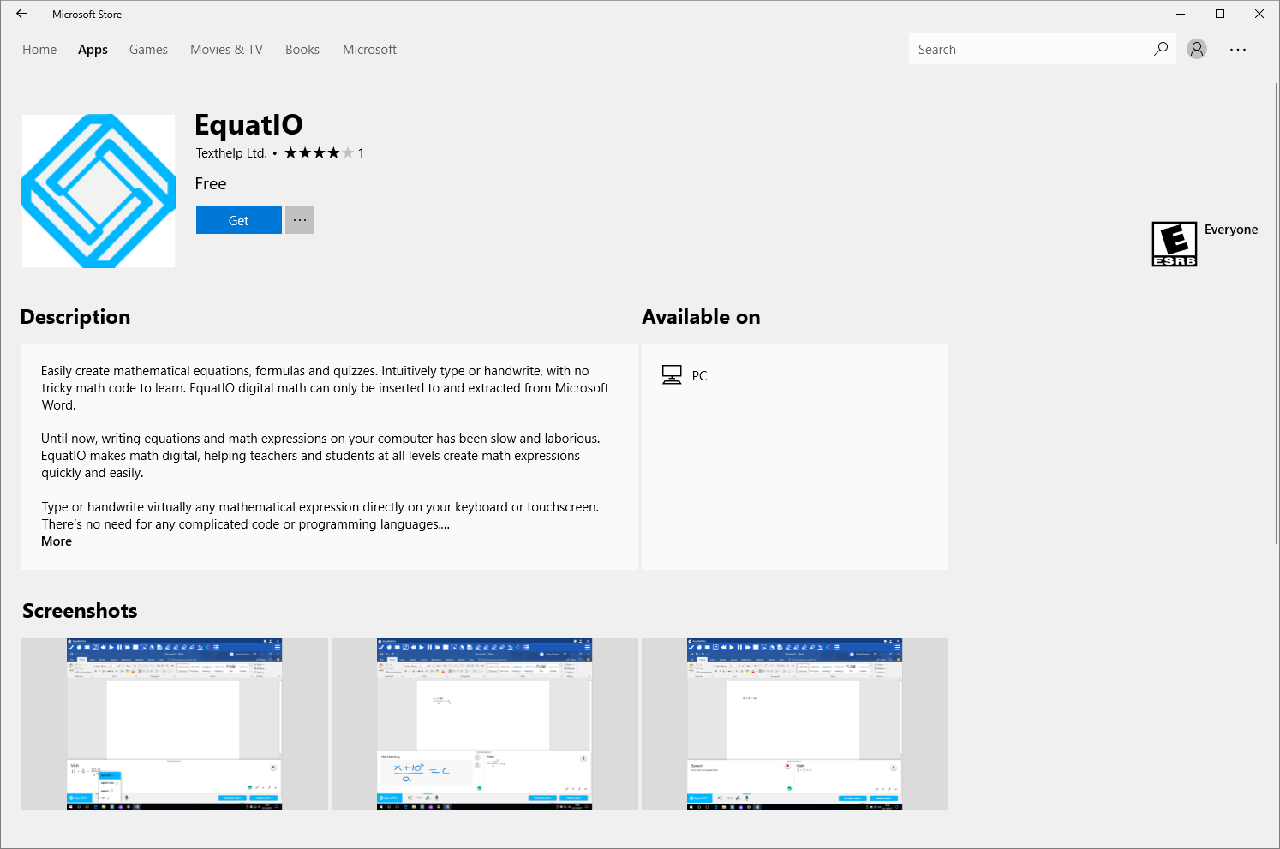
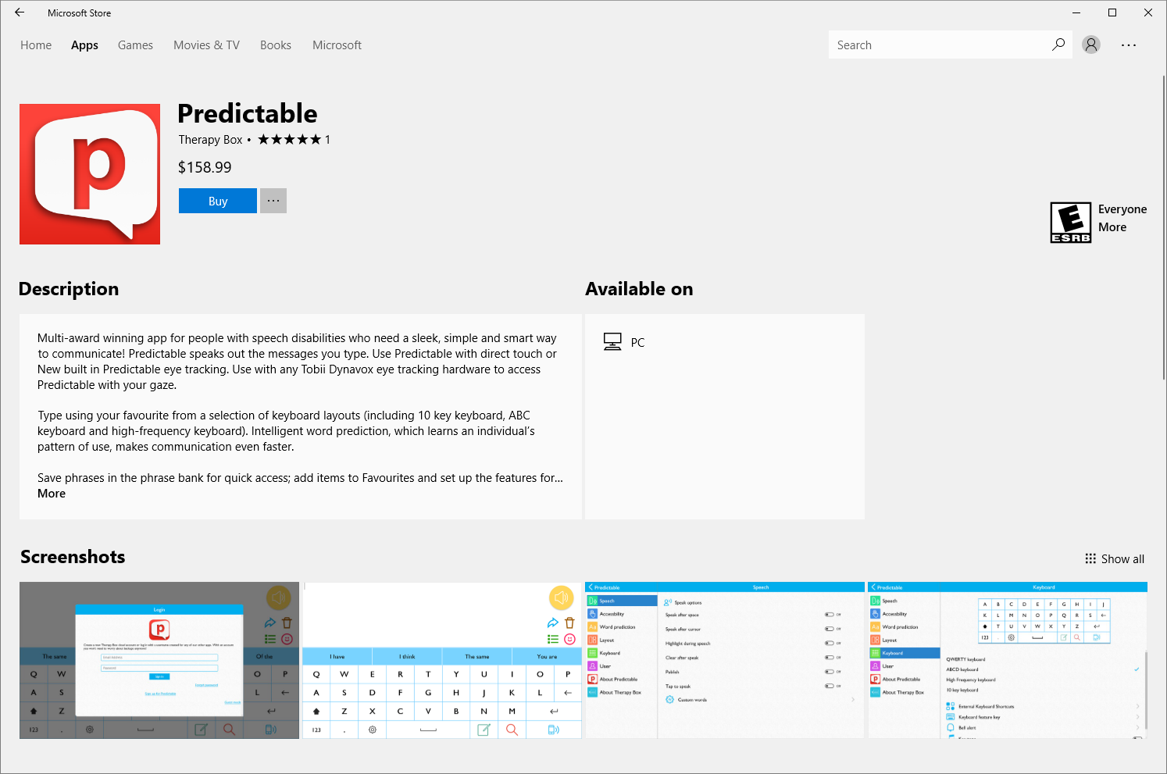
Partner Solutions
Windows has a growing number of accessibility apps and extensions
Spotlight: Accessibility Store Apps – Recently Added!

Slide 23
Part 3
Show me.
Microsoft Culture
Windows Accessibility
Accessibility Demos
Conclusion and Call to Action

Slide 24
Part 4
Wrap it up!
Microsoft Culture
Windows Accessibility
Accessibility Demos
Conclusion and Call to Action

Slide 25
Microsoft Mission, continued
Microsoft Mission
Empower every person and every organization on the planet to achieve more

Slide 26
Call to Action
1
2
3
Become a Windows 10 Insider
Explore Ease of Access
Share Your Feedback
Go to https://insider.windows.com/ to learn how to get preview versions of Windows 10
Try features that make your device easier to use
Press Windows Key + F to launch the Feedback Hub and share how we can improve

Slide 27
Resource Links
Microsoft at CSUN
aka.ms/CSUN2018
Answer Desk for Accessibility Support
aka.ms/eDAD
Microsoft Accessibility Overview
Microsoft.com/Accessibility

Slide 28
We want to hear from you.
Connect with us in person today or anytime through our support and feedback channels.
Disability Answer Desk for phone/chat/ASL Help: Aka.ms/AccessibilitySupport
User voice Forum for Accessibility Feedback: Aka.ms/AccessibilityFeedback

Slide 29

@jeffreyspetty

